Slide 1
Food Truck Favorites haiyun yuan yun gu jiajia ding

Slide 2
Feature list
See images of food trucks of different cuisines
Check food truck info, menu, review & ratings, map
User login/register
Filter, search bar feature
Add to cart and checkout

Slide 3
UI Design

Slide 4
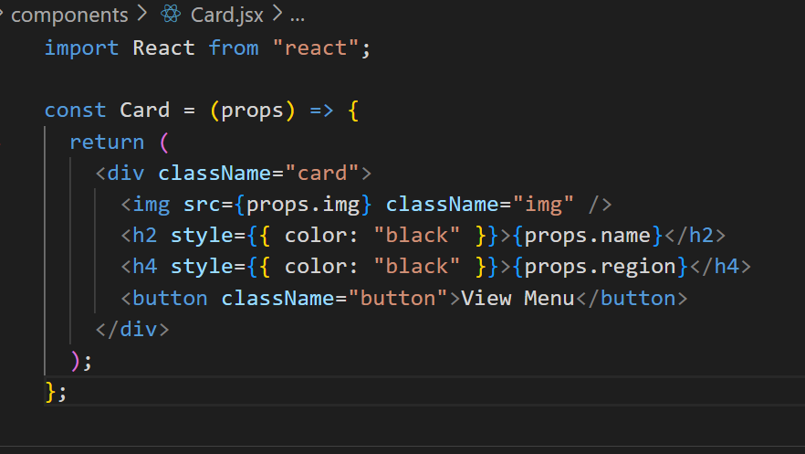
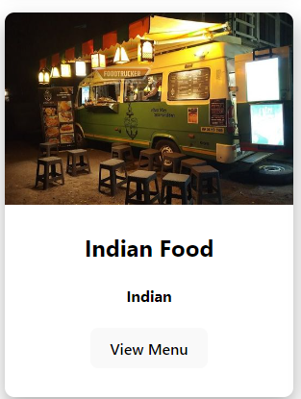
MVP (Minimal viable product) code example

Slide 5
Demo implementation

Slide 6
Thank you

